Slide 1
LIS

Slide 2
Management
Definition:
An ongoing process that seeks to achieve the objectives of an organisation in the most efficient possible ways .
The attainment of objectives.
Or controlling and organising an organisation.

Slide 3
Medical Laboratory Management
an ongoing process that seeks to achieve the objectives of a medical laboratory.
The objectives of a medical laboratory are providing its customers (physicians and patients) accurate results which contribute to clinical treatment.

Slide 4
Definition of laboratory quality
Laboratory quality can be defined as accuracy, reliability and timeliness of reported test results.
When making measurements, there is always some level of inaccuracy. The challenge is to reduce the level of inaccuracy as much as possible, given the limitations of our testing systems. An accuracy level of 99% may at first glance appear acceptable, but the resulting 1% error can become quite large in a system where many events occur, such as laboratory testing.

Slide 5
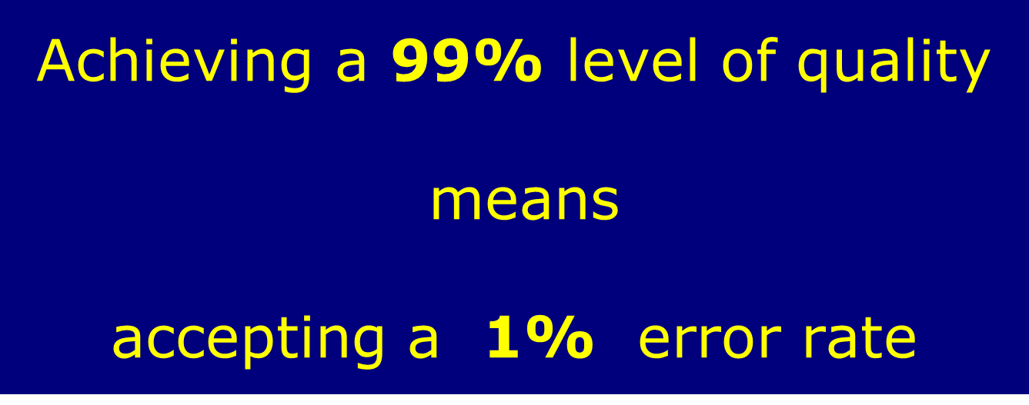

Level of accuracy required

Slide 6

laboratory results must be:
Accurate,
reliable, and
As fast as possible.

Slide 7
Negative consequences of laboratory error:
Unnecessary treatment.
Treatment complications.
Failure to provide the proper treatment.
Delay in correct diagnosis.
Additional and unnecessary diagnostic testing.

Slide 8
The laboratory is a complex system, involving many steps of activity and many people.
The complexity of the system requires that many processes and procedures be performed properly.
Therefore, the quality management system model, which looks at the entire system, is very important for achieving good laboratory performance.

Slide 9
Quality management system
Ongoing process to achieve the aim of laboratory ( get reliable accurate and timely results ) with regard to quality.

Slide 10
Complexity of a Laboratory System
Pre examination
Reporting
Patient/Client Prep
Sample Collection
Postexamination
Data & Laboratory Management
Safety
Customer Service
Sample Receipt and Accessioning
Record Keeping
Sample Transport
Quality Control Testing
Examination

Slide 11
Pre examination
Test selection
Sample Collection
Sample Transport

Slide 12

Path of Workflow
THE PATIENT Test selection
Sample Collection
Pre examination Phase
Sample Transport
Laboratory Analysis Examination Phase
Report Transport
Report Creation
Result Interpretation Post examination Phase

Slide 13
Post examination
Result Interpretation
Report Creation
Record Keeping

Slide 14
Factors to assure quality in the laboratory.
Some of these factors include:
Competent and knowledgeable staff.
Good-quality reagents and equipment.
The laboratory environment.
Quality control procedures.
Communications.
Record keeping.

Slide 15
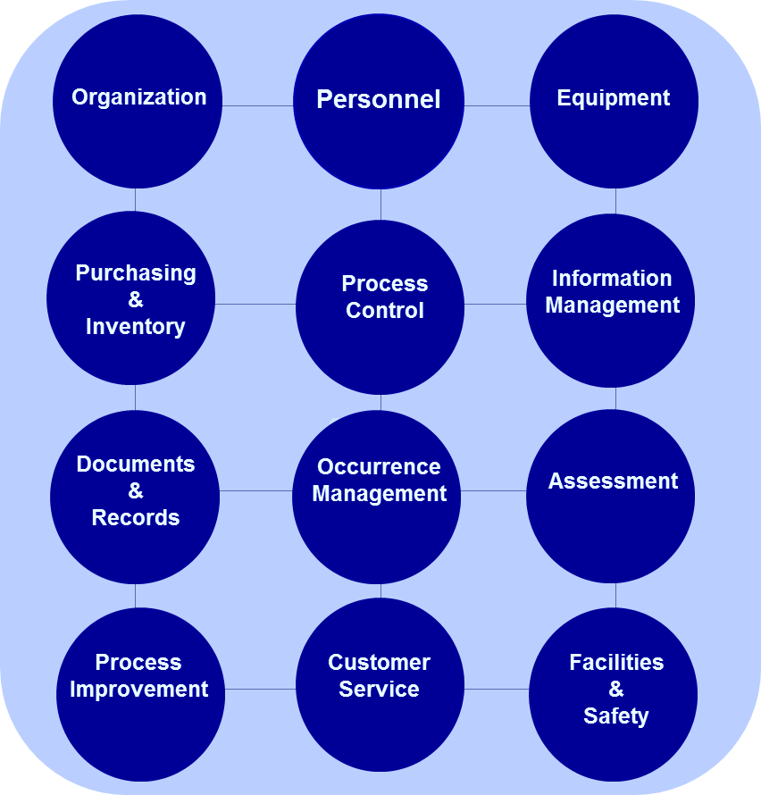
The quality management system model
Factors to assure quality in the laboratory

Slide 16
The quality model used organizes all of the laboratory activities into 12 quality system essentials.
These quality system essentials are a set of coordinated activities that serve as building blocks for quality management.

Slide 17
Organization
In order to have a functioning quality management system, the structure and management of the laboratory must be organized so that quality policies can be established and implemented.
Personnel
The most important laboratory resource is competent, motivated staff.

Slide 18
Organization
Responsibilities, Authorities
Communication
Provision of resources
Quality Policy

Slide 19
Equipment
Many kinds of equipment are used in the laboratory, and each piece of equipment must be functioning properly. Choosing the right equipment, installing it correctly, ensuring that new equipment works properly, and having a system for maintenance are all part of the equipment management programmer in a quality management system.

Slide 20
Purchasing and inventory:
The management of reagents and supplies in the laboratory is often a challenging task.
proper management of purchasing and inventory:
produce cost savings.
ensure supplies and reagents are available when needed.

Slide 21
Process control
You have to try to apply the quality in the following laboratory testing processes:
Pre examination
Test selection and performance
Post examination

Slide 22
Information management
The product of the laboratory is information, primarily in the form of test reporting. Information (data) needs to be carefully managed to ensure accuracy and confidentiality, as well as accessibility to the laboratory staff and to the health care providers. Information may be managed and conveyed with either paper systems or with computers.

Slide 23
Documents and records
Documents are needed in the laboratory to inform how to do things, and laboratories always have many documents. Records must be maintained so as to be accurate and accessible.

Slide 24


Documents and records

Slide 25

Occurrence management
An “occurrence” is an error or an event that should not have happened. A system is needed to detect these problems or occurrences, to handle them properly, and to learn from mistakes and take action so that they do not happen again.

Slide 26
Assessment
The process of assessment is a tool for examining laboratory performance and comparing it to standards, the performance of other laboratories.
Laboratory quality standards are an important part of the assessment process, serving as benchmarks for the laboratory.

Slide 27
Process improvement
The primary goal in a quality management system is continuous improvement of the laboratory processes, and this must be done in a systematic manner.
Customer service
It is essential that clients of the laboratory receive what they need. The laboratory should understand who the customers are, and should assess their needs and use customer feedback for making improvements.

Slide 28
Security and safety
Security: which is the process of preventing unwanted risks and hazards from entering the laboratory space.
Safety: which includes policies and procedures to prevent harm to workers, visitors and the community.

Slide 29
International laboratory standards
A part of quality management is assessment, measuring performance against a standard.
( The most important systems are ISO and CLSI ).

Slide 30
Standards organizations
ISO International Organization for Standardization | CLSI Clinical and Laboratory Standards Institute (formerly known as NCCLS)
Guidance for quality in manufacturing and service industries | Standards, guidelines, and best practices for quality in medical laboratory testing
Broad applicability; used by many kinds of organizations | Detailed; applies specifically to medical laboratories

Slide 31
As a laboratorian, it is important to:
Be aware of basic safety rules and processes;
Understand the basics of safety and biosafety management issues when working with toxic chemicals, biological samples and physical hazards, and when interacting with patients.

Slide 32
Everyone in the laboratory is responsible for quality and safety..

Slide 33


